Slide 1
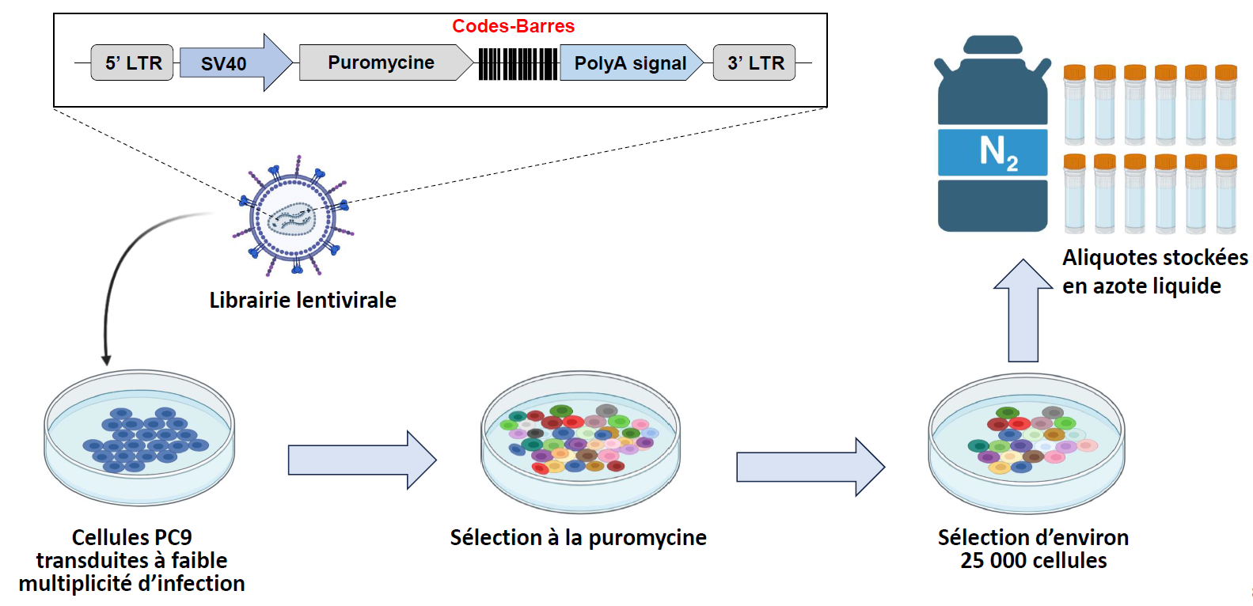

Slide 2
Workflow
-eliminate barcodes for which the combined counts of the 4 controls are <5
-normalize barcodes so that total number of counts is 100 000
-calculate mean of the 4 controls
-calculate the fold change vs control (mean) for each drug replicate
-if fc>3 → 1, if not → 0
Osimer1_100n_exp010821_run180821_07 | Osimer2_100n_exp010821_run180821_08 | Osimer3_100n_exp010821_run180821_09 | Osimer4_100n_exp010821_run180821_10 | , | Osimer1_100n_exp010821_run180821_07 | Osimer2_100n_exp010821_run180821_08 | Osimer3_100n_exp010821_run180821_09 | Osimer4_100n_exp010821_run180821_10 | Osimer_100n_exp010821_run180821
0,31 | 0,25 | 0,34 | 0,34 |  | 0 | 0 | 0 | 0 | 0
0,27 | 0,19 | 0,33 | 0,24 |  | 0 | 0 | 0 | 0 | 0
5,44 | 4,50 | 5,44 | 4,78 |  | 1 | 1 | 1 | 1 | 4
0,92 | 0,79 | 0,69 | 0,63 |  | 0 | 0 | 0 | 0 | 0
0,53 | 0,62 | 0,73 | 0,58 |  | 0 | 0 | 0 | 0 | 0
0,22 | 0,28 | 0,22 | 0,14 |  | 0 | 0 | 0 | 0 | 0
0,50 | 0,46 | 0,59 | 0,54 |  | 0 | 0 | 0 | 0 | 0
1,28 | 1,67 | 1,54 | 1,73 |  | 0 | 0 | 0 | 0 | 0
0,51 | 0,59 | 0,66 | 0,53 |  | 0 | 0 | 0 | 0 | 0
0,39 | 0,53 | 0,50 | 0,48 |  | 0 | 0 | 0 | 0 | 0
-calculate the sum for the four replicates

Slide 3
What are the chances to have a barcode randomly enriched in all four replicates?
Osimertinib
Trametinib
Pemetrexed
Osimer1_100n_exp010821_run180821_07 | Osimer2_100n_exp010821_run180821_08 | Osimer3_100n_exp010821_run180821_09 | Osimer4_100n_exp010821_run180821_10 | sum | Tramet1_030n_exp010821_run180821_11 | Tramet2_030n_exp010821_run180821_12 | Tramet3_030n_exp010821_run180821_13 | Tramet4_030n_exp010821_run180821_14 | sum | Pemetr1_100n_exp010821_run180821_15 | Pemetr2_100n_exp010821_run180821_16 | Pemetr3_100n_exp010821_run180821_17 | Pemetr4_100n_exp010821_run180821_18 | sum
0 | 0 | 0 | 0 | 0 | 0 | 0 | 0 | 0 | 0 | 0 | 0 | 0 | 0 | 0
0 | 0 | 0 | 0 | 0 | 0 | 0 | 0 | 0 | 0 | 0 | 0 | 0 | 0 | 0
1 | 1 | 1 | 1 | 4 | 0 | 0 | 0 | 0 | 0 | 0 | 0 | 0 | 0 | 0
0 | 0 | 0 | 0 | 0 | 0 | 0 | 0 | 0 | 0 | 0 | 0 | 0 | 0 | 0
0 | 0 | 0 | 0 | 0 | 0 | 0 | 0 | 0 | 0 | 0 | 0 | 0 | 0 | 0
0 | 0 | 0 | 0 | 0 | 0 | 0 | 0 | 0 | 0 | 0 | 0 | 0 | 0 | 0
0 | 0 | 0 | 0 | 0 | 0 | 0 | 0 | 0 | 0 | 0 | 0 | 0 | 0 | 0
0 | 0 | 0 | 0 | 0 | 0 | 0 | 0 | 0 | 0 | 0 | 0 | 0 | 0 | 0
0 | 0 | 0 | 0 | 0 | 0 | 0 | 0 | 0 | 0 | 0 | 0 | 0 | 0 | 0
0 | 0 | 0 | 0 | 0 | 0 | 0 | 0 | 0 | 0 | 0 | 0 | 0 | 0 | 0
0 | 0 | 0 | 0 | 0 | 0 | 0 | 0 | 0 | 0 | 0 | 0 | 0 | 0 | 0
Total barcodes: 10881
Osimertinib
Trametinib
Pemetrexed
630 | 626 | 658 | 622 |  | 1091 | 1061 | 1017 | 1058 |  | 1711 | 1776 | 1741 | 1831
0,05789909 | 0,05753148 | 0,06047238 | 0,05716386 | 1,15E-05 | 0,10026652 | 0,09750942 | 0,09346567 | 0,09723371 | 8,8E-05 | 0,15724658 | 0,16322029 | 0,16000368 | 0,16827497 | 0,00069
 |  |  |  | 0,125 |  |  |  |  | 0,967 |  |  |  |  | 7,519
 |  |  |  | 294 |  |  |  |  | 323 |  |  |  |  | 608
Probability of having sum=4
Expected barcodes with sum=4
Actual number of barcodes showing sum=4: 294 (osimertinib, 2,7% of detected barcodes)
323 (trametinib, 2,97% of detected barcodes)
608 (pemetrexed, 5,59% of detected barcodes)
Observed barcodes with sum=4

Slide 4
-I did this for all the experiments, then David assembled the different files with Galaxy
 | Osimer_100n_exp010821_run180821 | Tramet_030n_exp010821_run180821_11 | Pemetr_100n_exp010821_run180821_15
CAGCTTGACCATCTGCTGTTACTCGGACAGGAATAAGGCGA | 0 | 0 | 0
CATGGCGAAGATGAGCGAAGACTGGGACAGGATTGACGCGA | 0 | 0 | 0
GATCTCGTAGAACATTTGCGGATACTCCTACAACGTTTAGG | 4 | 0 | 0
GATCACCTTGAGCATTAGCCGGGACTGTTACACGTTTGAGG | 0 | 0 | 0
GATCAAGGTGAAGATGTGCACCGACTGACACATCATTAACG | 0 | 0 | 0
GATCAACTTGACGATGAGCAAGTACTGGTACATGGGTCACG | 0 | 0 | 0
GATCAGCAGGAGGATAAGCTTTTACTGTAACATCGTTGAGG | 0 | 0 | 0
CTGCGAGAACATCAGCATCGACTCCAACAGCCTATAGGCGA | 0 | 0 | 0
GATCAGCATGAAGATGTGCTGATACTGTTACATCCATTACG | 0 | 0 | 0
GATCTAGTGGAAGATTAGCATATACTGGAACAGCTGTCAGG | 0 | 0 | 0
GATCAGCGGGAACATTTGCGCCCACTGACACATCAAAGACG | 0 | 0 | 0
CTTCACGATGATAAGCTTGAACTGGTACATGATATAGGCGA | 4 | 0 | 0
CTGGTTGAGGATAAGCACCAACTCTCACAGGGGTCACGCGA | 0 | 0 | 0
CTTGTTGAACATGTGCGGGGACTGGAACATGCAACAGGCGA | 0 | 0 | 0
CACCCGGAGCATTTGCGTGGACTCGAACATGGTAGAGGCGA | 4 | 0 | 0
GATCTGGGCGAGGATGTGCTATGACTGGTACACGGCAGACG | 4 | 0 | 0

Slide 5
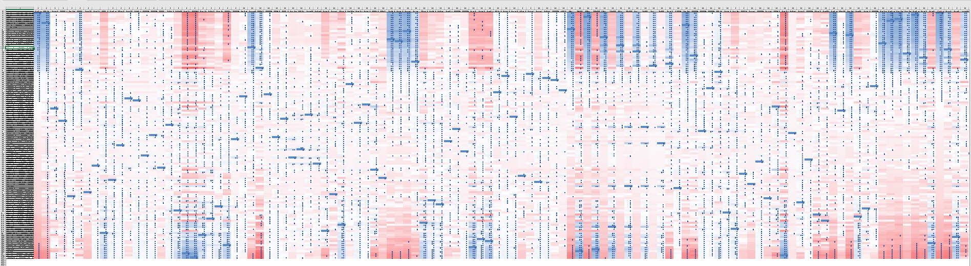
We obtained a table with 121 columns (treatments) and 26712 barcodes
- I kept only the barcodes that were present in all the drugs/columns: 6111 barcodes selected
- I transformed 4 → 1 and the rest → 0 (binary) [except for osim three months, 3 replicates]
-Correlation matrix for the treatments

Slide 6
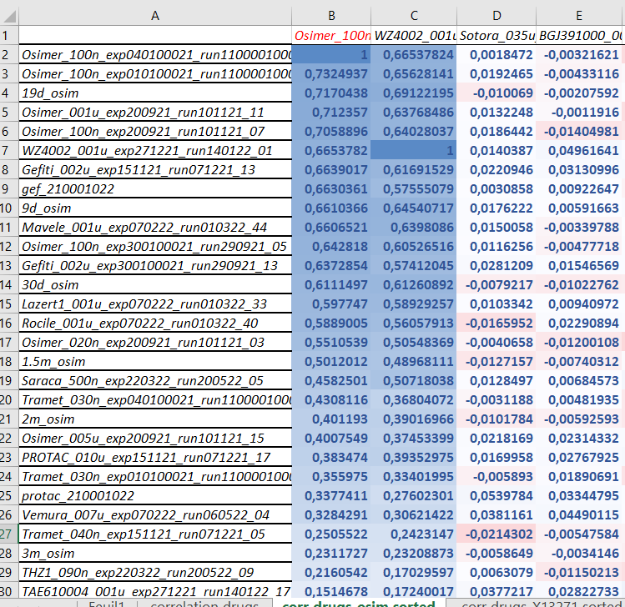

Slide 7
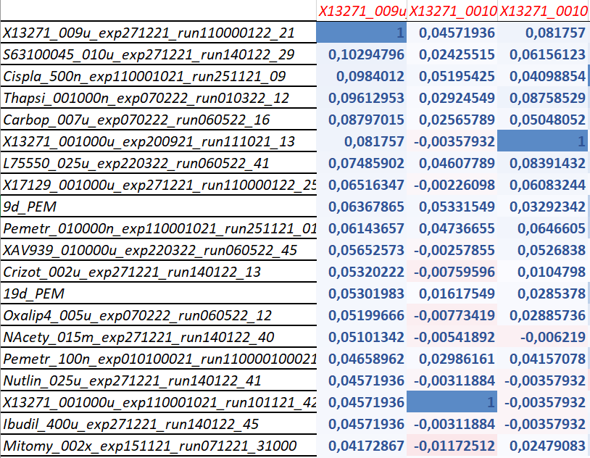
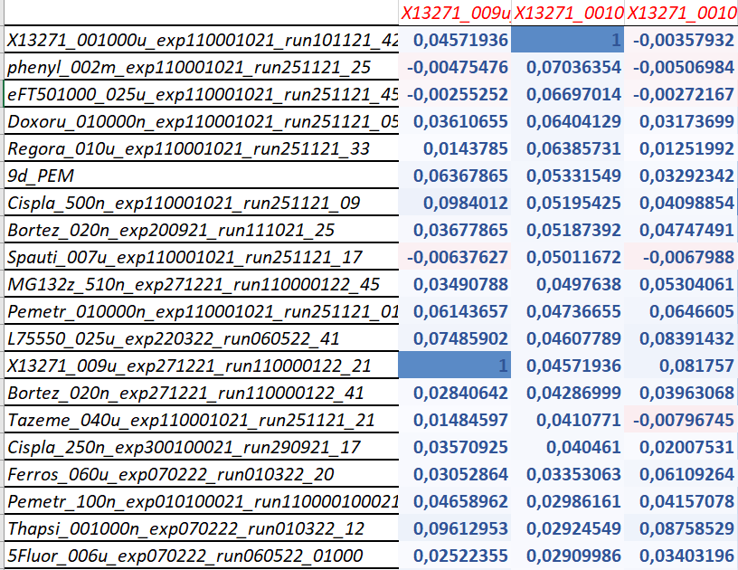
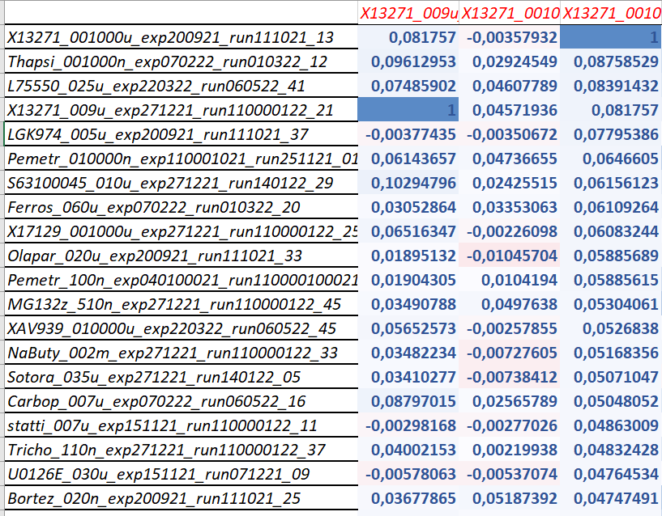

Slide 8
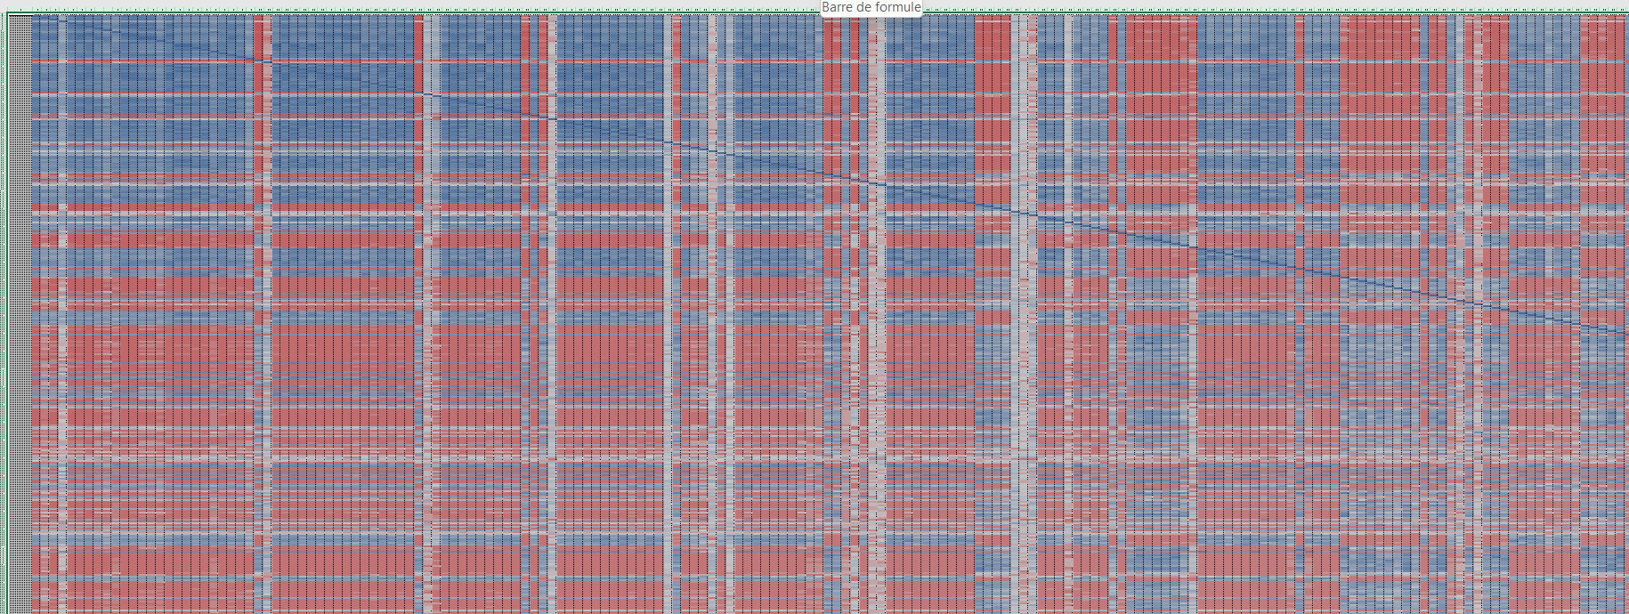
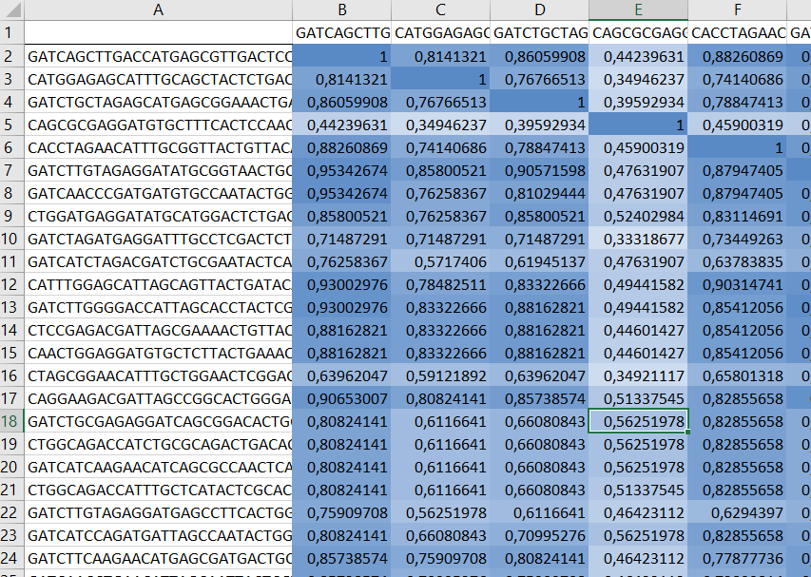
-Correlation matrix for the barcodes
-I selected barcodes displaying a sum of at least 1 → 4106 barcodes
-I selected barcodes displaying a sum of at least 10 → 657 barcodes

Slide 9
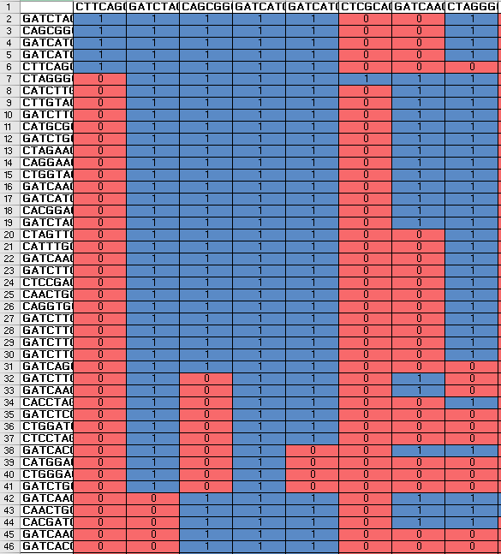
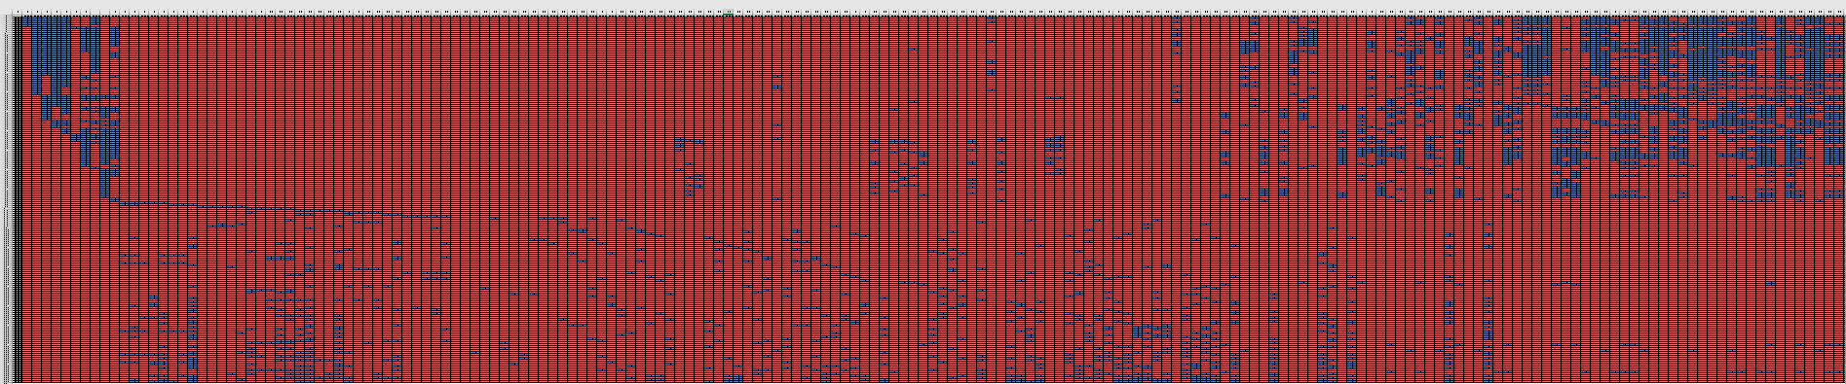
- To select barcodes highly correlated:
CC > 0,8 → 1 ; CC ≤ 0,8 → 0
- I discarded barcodes with sum < 5 (205 barcodes remaining)

